Slide 1
Kruskal’s Algorithm implementation with vEB tree and its comparison with AVL Tree and Union Find
Rishab 2019201050
Aman Dev Nautiyal 2019201095

Slide 2
Goal:
Comparison of performance of Kruskal’s Minimum Spanning Tree algorithm with its implementation through van Emde Boas Tree and AVL tree with Union Find.

Slide 3
About: Minimum Spanning Tree
Minimum-Cost Spanning Trees: A Spanning Tree for G is a subgraph of G that it is a free tree connecting all vertices in V. The cost of a spanning tree is the sum of costs on its edges.
An MST of G is a spanning tree of G having a minimum cost.
A spanning tree is always connected and has no cycles with atmost n-1 edges, where n is the number of vertices

Slide 4
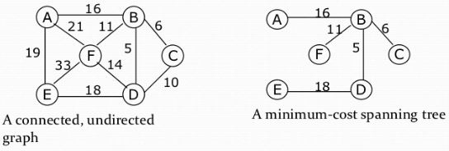
Example:

Slide 5
About: Kruskal’s Algorithm
Kruskal's algorithm is a minimum-spanning-tree algorithm which finds an edge of the least possible weight that connects any two trees in the forest.
It is a greedy Algorithm.
This means it finds a subset of the edges that forms a tree that includes every vertex, where the total weight of all the edges in the tree is minimized.

Slide 6
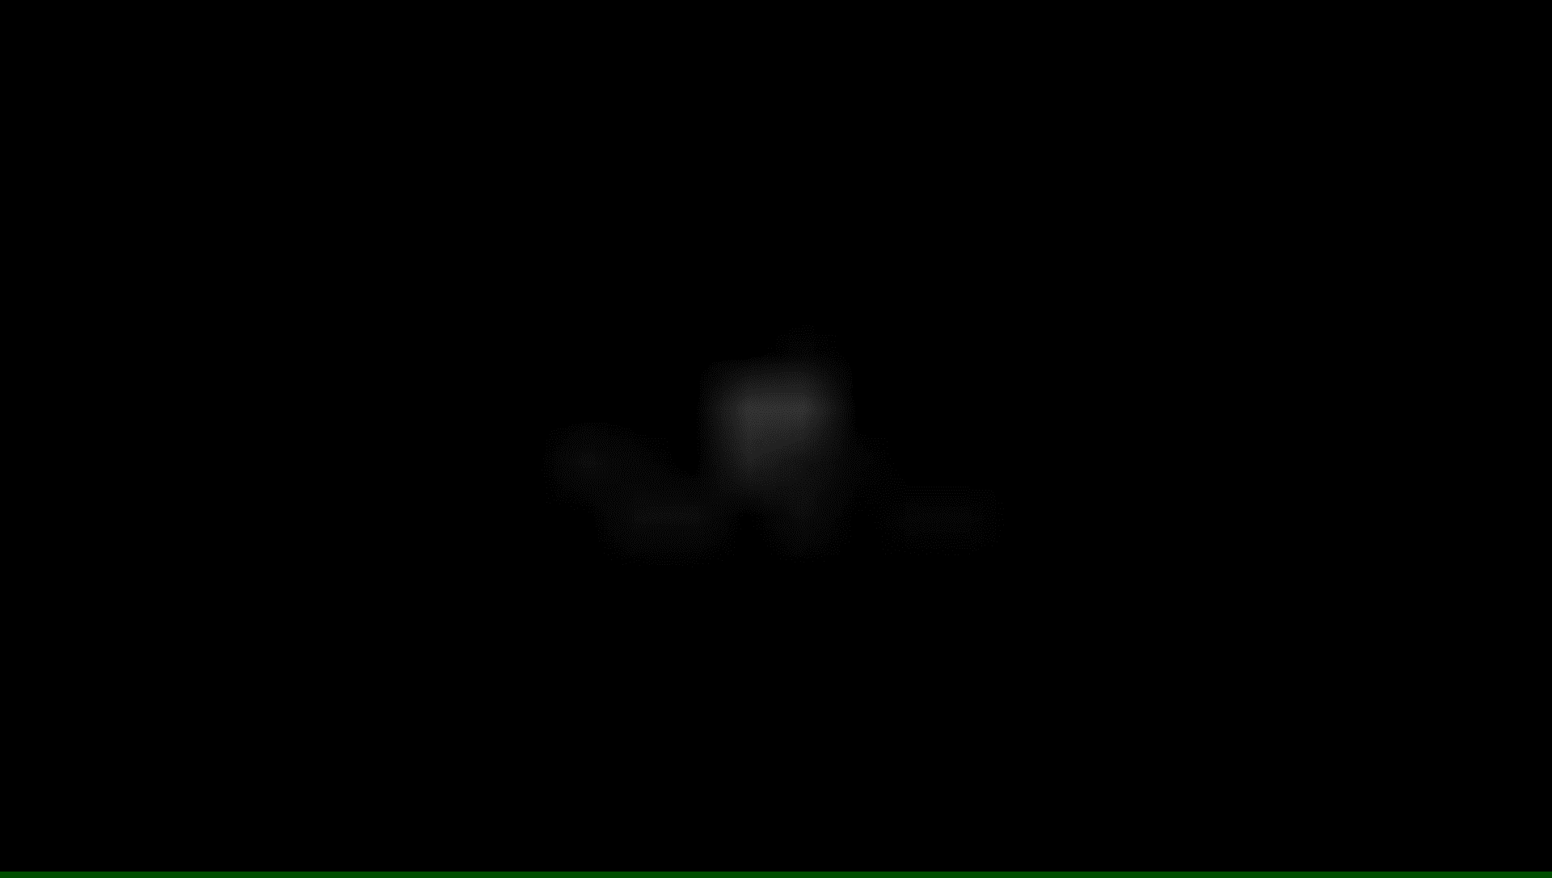
Kruskal’s Algo Demo:

Slide 7
AVL Tree:
An AVL Tree is a self-balancing binary search tree. It was the first such data structure to be invented.
In an AVL Tree, the heights of the two child subtrees of any node differ by at most one. If difference of height between heights of Left Subtree and Right Subtree, rebalancing is done to restore this property.
Insertions and deletions may require the tree to be rebalanced by one or more tree rotations.
Find minimum operation takes time in O(height) ,which is O(log n) assured by the AVL’s height balance property.
All other types of search operations like max(T),find(T,x) also take O(log n) time.

Slide 8
AVL demo:

Slide 9
The Van Emde Boas Tree:
Given a set S of elements such that the elements are taken from universe {0, 1, …. u-1}.
Van Emde Boas tree (or vEB tree) supports insert(), delete, find(), successor() and predecessor() operations in O(Log Log u) time, and max() and min() in O(1) time.
A thing to note about the vEB trees is that the time taken by it to perform the above operations is independent of the elements which are actually present in the tree. It depends on the universe size i.e ‘u’.

Slide 10
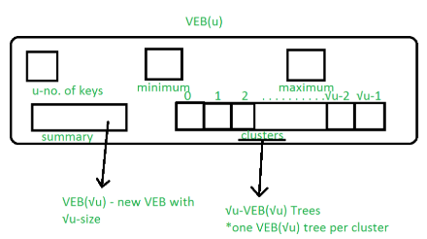
Some more properties:
Van Emde Boas Data Structure’s key set must be defined over a range of 0 to n(n is positive integer of the form 2^{k}) and it works when duplicate keys are not allowed.
Van Emde Boas Tree is a recursively defined structure.
A VEB structure looks as follows:

Slide 11
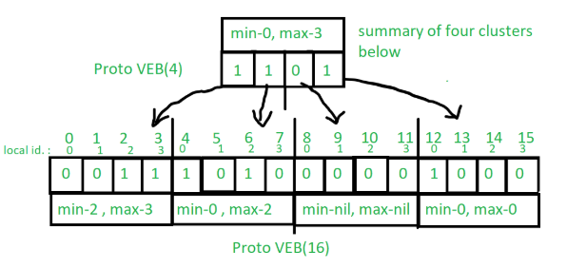
Structure of a VEB Tree:

Slide 12
Advantages of VEB Trees:
Advantages of adding Maximum and Minimum attributes, which help to decrease time complexity.If any of Minimum and Maximum value of VEB Tree is empty(NIL or -1 in code) then there is no element present in the Tree.
If both Minimum and Maximum is equal then only one value is present in the structure.
If both are present and distinct then two or more elements are present in the Tree.
We can insert and delete keys by just setting maximum and minimum values as per conditions in constant time( O(1) ) which helps in decreasing recursive call chain: If only one key is present in the VEB then to delete that key we simply set min and max to the nil value. Similarly, if no keys are present then we can insert by just setting min and max to the key we want to insert. These are O(1) operations.
In successor and predecessor queries, we can take decisions from minimum and maximum values of VEB,

Slide 13
Disjoint-set-Union
In Kruskal’s Algorithm, we create forests in such a way that whenever we insert a new edge into the future MST ,it is inserted making sure that it doesn’t create a cycle .
How would we check if adding an edge {u, v} would create a cycle?
Would create a cycle if u and v are already in the same component.
Components merge when we add an edge
Need a way to: check if u and v are in same component and to merge two components into one.
Solution:Union-Find ADT

Slide 14
About Union Find ADT
The Union-Find abstract data type supports the following operations:
UF.create(S) — create the data structure containing |S| sets, each containing one item from S.
- O(|S|) time.
UF.union (A, B) - connect two elements A and B. Find (A, B) - find, is there any path connecting two elements A and B.
-O(1) time.
UF. Find (A, B) - check if Arr[ A ] is equal to Arr[ B ] or not. Union (A, B) - Connect A to B and merge the components having A and B by changing all the elements ,whose value is equal to Arr[ A ], to Arr[ B ]. -O(1) time.

Slide 15
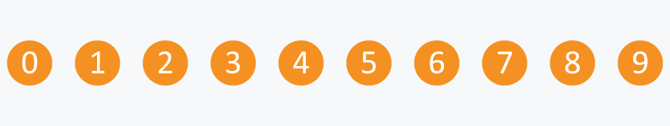
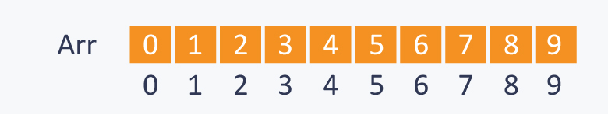
Example of Union-Find operations
Initially there are 10 subsets and each subset has single element in it.

Slide 16
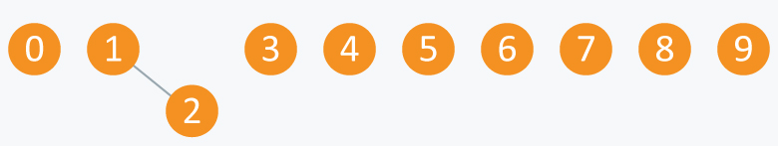
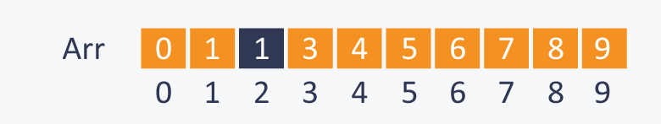
Let’s perform some Operations: 1) Union(2, 1)
Arr will be:

Slide 17
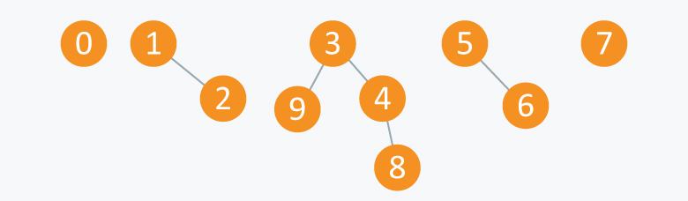
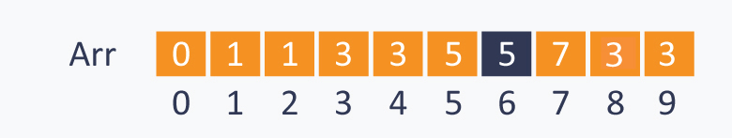
Further after performing Union(4, 3) ,Union(8, 4) , Union(9, 3) and Union(6, 5)
Arr looks as follows:
Find (0, 7) - as 0 and 7 are disconnected ,this will gives false result
Find (8, 9) -though 8 and 9 are not connected directly ,but there exist a path connecting 8 and 9, so it will give us true result.

Slide 18
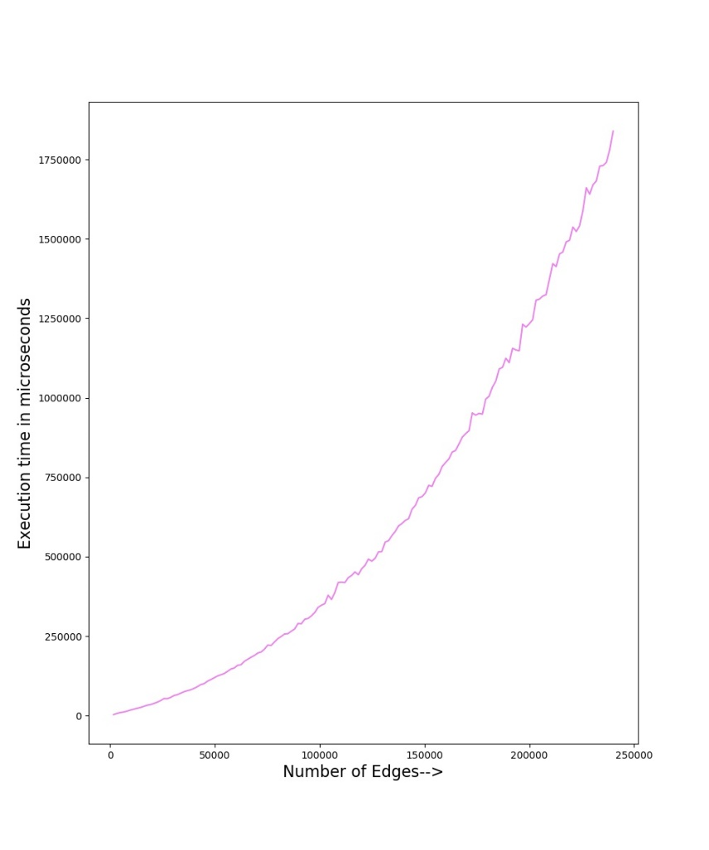
Comparisons: AVL Tree

Slide 19
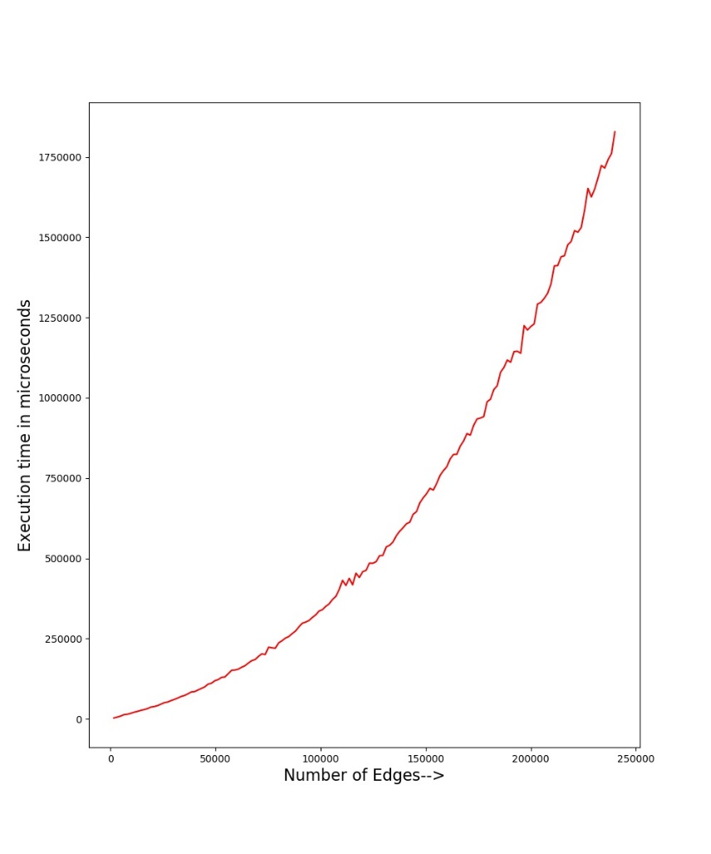
Comparisons:VEB Tree

Slide 20
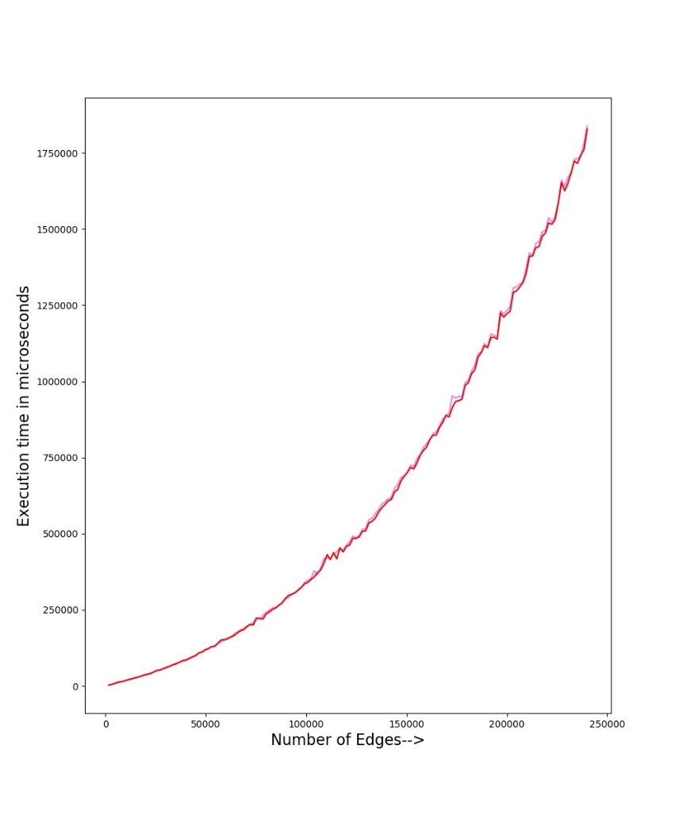
Comparisons:VEB vs AVL

Slide 21
Observations:
We can see that for the initial values, the AVL tree outperforms the VEB tree. The reason for this are the constants that are associated with the VEB tree, which has a fixed structure, unlike the dynamically changing AVL tree.
For higher values, the VEB tree starts to outperform the AVL tree as the O(log log u)(u being universe size) factor of vEB tree becomes significantly smaller than the O(log n) (n being the number of edges in tree) of the AVL tree.
The increase in performance is not very pronounced at the given range. However following the same trend, the performance of vEB tree should be considerably better than the AVL tree at higher number of edges and the weight range.

Slide 22
Thank You!

